Slide 1

Quantiphi Analytics Solutions
Neeharika Nagori
Mrunmayee Waingankar
Shubham Zope

Slide 2

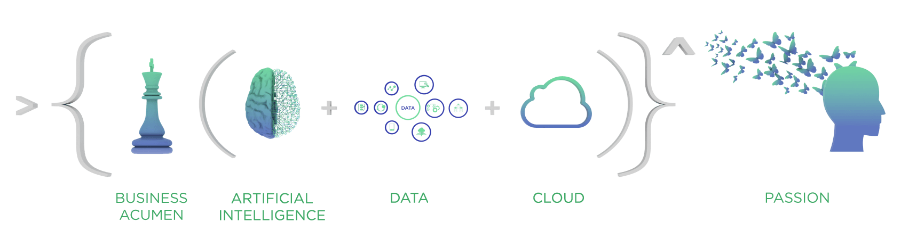

Slide 3
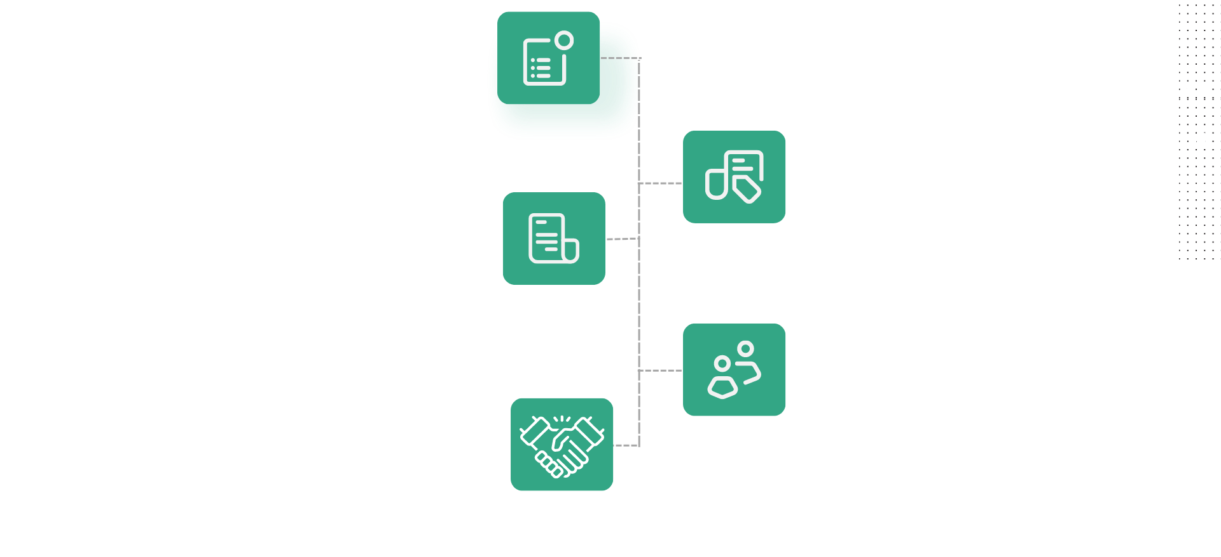
About Quantiphi

Slide 4
Company Details
Name of the Company: Quantiphi Analytics Solution Private Limited
Company status : Dream
Date of recruitment drive : 16th,17th and 18th August 2022
Branches Eligible: BE ( CMPN, INFT, EXTC, ETRX, INSTRU, MCA, M.E.)
Eligibility Criteria: CGPA 7.17 and above and 60% in 10th & 12th/Diploma, No live ATKT, Graduation score 65% and above for MCA
Salary: CTC: 8.5 LPA ( 6.5 FIXED + 2 QCDP REWARD)
4 months internship compulsory
Position : Framework Engineer / Business Analyst / Machine Learning Engineer

Slide 5
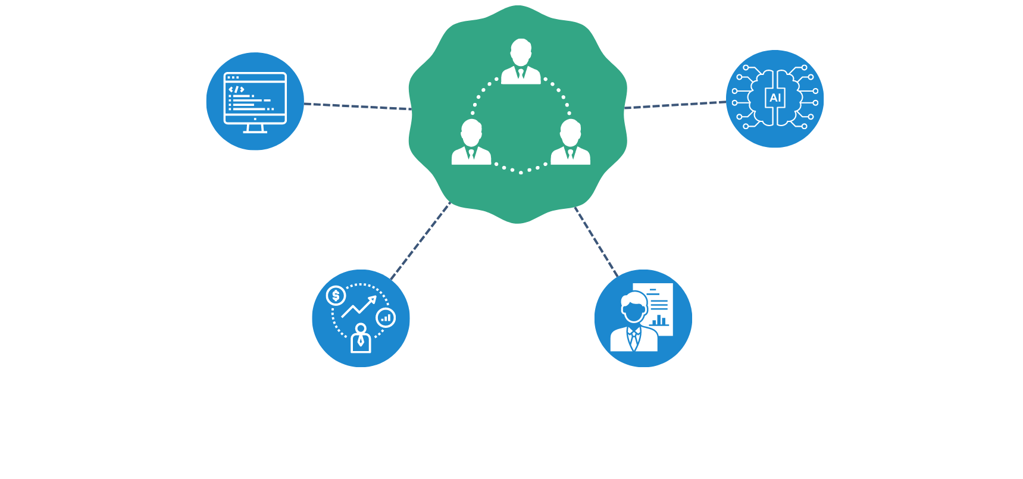
Roles Offered

Slide 6
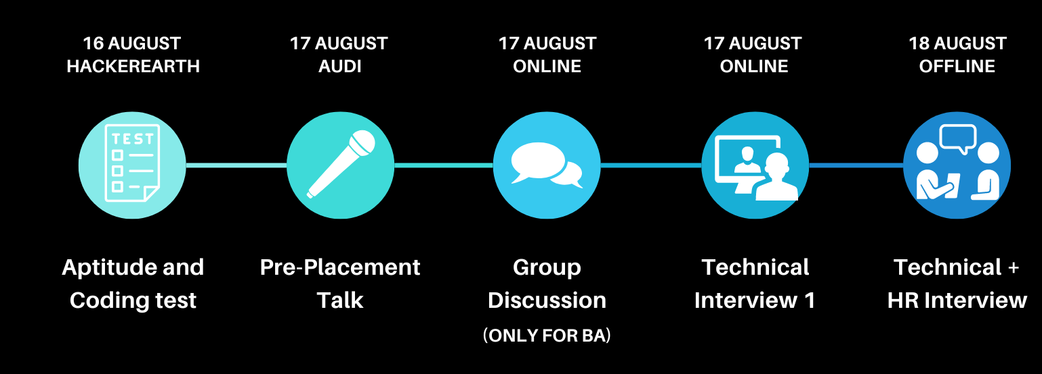
Placement Process

Slide 7
Round 1 : Aptitude and Coding Test
Platform - Hackerearth.
Test consisted of 7 sections for approx. 86 minutes.
Quantitative, Verbal, Statistical, Technical, Probability, Web technology, SQL, Ml, OS, CN, DBMS, 2 Coding Questions.
Level of the test was medium to high.
One needs to solve the question as fast as possible as there is a sectional timer.
After round 1 from 316 students, 86 were shortlisted for next round

Slide 8
Round 2 : Group Discussion
(Business Analyst only)
Topics:
Sports helps lower the tension between the boundaries.
Thoughts about the supply chain management.
Topic-> 2 min prep -> 6 min discussion -> 1 min conclude
What to do
Put your point forward properly
Tackle at least 2 point
Conclude
Tips:
Formulate your thoughts and choose your side wisely
Convey your POV accurately and concisely.
Do not speak over other candidates and allow them to finish speaking.
Refer to group discussions on youtube for practice.

Slide 9
Experience of Mrunmayee Waingankar (Framework Engineer)
Round 3: Technical Interview
The interview was scheduled at 5:00 pm.
Platform used - Superset
The interview latest for around 20-30 minutes
Introduction
Projects on which I have worked
Theory - OOPS, DSA, SQL and java related questions.
Few riddles like 2 candles will burn in 30 mins each, How will you count 45 mins
Asked to write codes for 2-3 problems (basic)
Asked about why I want to join Quantiphi
Finally he asked if I have any questions.
After round 2, 39 were shortlisted from 86

Slide 10
Experience of Mrunmayee Waingankar (Framework Engineer)
Round 4: Technical + HR
Introduction.
Detailed discussion about projects
Tech stack used and why
OOPS, DSA, SQL related questions were asked
Riddles
If you are given X amount of money, cost of apple is A, cost of oranges is B and cost of bananas is C , in how many ways can you buy different fruits?
Given problems and asked to tell the approach of solving it or write the pseudocode for the same. (level average-good)
Recursion problem
Optional subjects and why you chose them.
In the end asked if you I have any questions.
The interview was of around 20-30 mins.

Slide 11
Experience of Shubham Zope (Framework Engineer)
Round 3: Technical Interview
My Interview was scheduled at 5:30 Pm. Slots of interview were between 3 to 9. They can ask you anytime to join the interview, so be ready.
Tell me about yourself
Projects on which I have worked
OOPS Concept
Asked to code inheritance concept in java.
SQL Queries on Joins, Procedure.
Questions on Node.js.
What is Quantiphi.
Finally he asked if I have any questions.
The interview was of 40 mins.
After round 2, 39 were shortlisted from 86

Slide 12
Experience of Shubham Zope (Framework Engineer)
Round 4: Technical + HR
Technical:
My best tech stack
Basics of DBMS Questions were asked like normalization, primary key etc.
Some questions were given and sql queries were asked to write for it.
Questions about OOPS Concept
Puzzles were asked. For puzzles reger geeksforgeeks.
Finally he asked if you have any questions.
The interview was of 30 mins.
HR:
Tell me about yourself
Hobbies
General conversation

Slide 13
Experience of Neeharika Nagori (Framework Engineer)
Round 3: Technical Interview
Platform used - Superset
The interview latest for around 35-40 minutes
No introduction, project discussion was asked
Questions on Java and OOPS
Many questions on sql commands were asked
Questions were given and I was asked to type the MySQL query for it.
I was asked to code for basic java problems
Complete set of questions was taken form Interviewbit practice sets
After round 2, 39 were shortlisted from 86

Slide 14
Experience of Neeharika Nagori (Framework Engineer)
Round 4: Technical + HR
Introduction.
Detailed discussion about projects by looking at resume
Tech stack used and why
ML questions on ML project mentioned in resume
Permutations of strings - Mathematical approach and further questions on it.
Write pseudo code for the same. (level average-good)
Recursion problem
In the end asked if you I have any questions.
The interview was of around 15-20 mins.

Slide 15
How to make your study plan?
For aptitude (quants, logical and verbal):
RS Aggarwal, IndiaBix, GeeksForGeeks
Puzzles from GeeksForGeeks
For Coding test :
Leetcode, Hackerrank, GeeksForGeeks, Codechef
For theory concepts: Gate Smashers, 5 Minutes Engineering, GeeksforGeeks, Javatpoint, Semester syllabus.
Refer previous year interview experiences from geeksforgeeks.

Slide 16
17 people were selected
9
5
3
Framework Engineer
Business Analyst
Machine Learning

Slide 17
If you have any queries you can contact us
Neeharika Nagori | 2019neeharika.nagori@ves.ac.in
Mrunmayee Waingankar | 2019mrunmayee.waingankar@ves.ac.in
Shubham Zope | 2019shubham.zope@ves.ac.in

